Slide 1
Digital Twin Technology
Presented By
Prithviraj Patil
1JS19CS125
Guide
K V Shanthala

Slide 2
Introduction
In recent years, Digital Twins (DT) have been implemented in different industrial sectors, in several applications areas such as design, production, manufacturing, and maintenance.
They are used for enhancing performance and reducing operating cost, offer the business including increased reliability of equipment and production lines
Technologies including Artificial Intelligence, Machine Learning, Deep Learning, IoT, sensor, simulation, connectivity and big data have led to sophisticated digital twins.

Slide 3
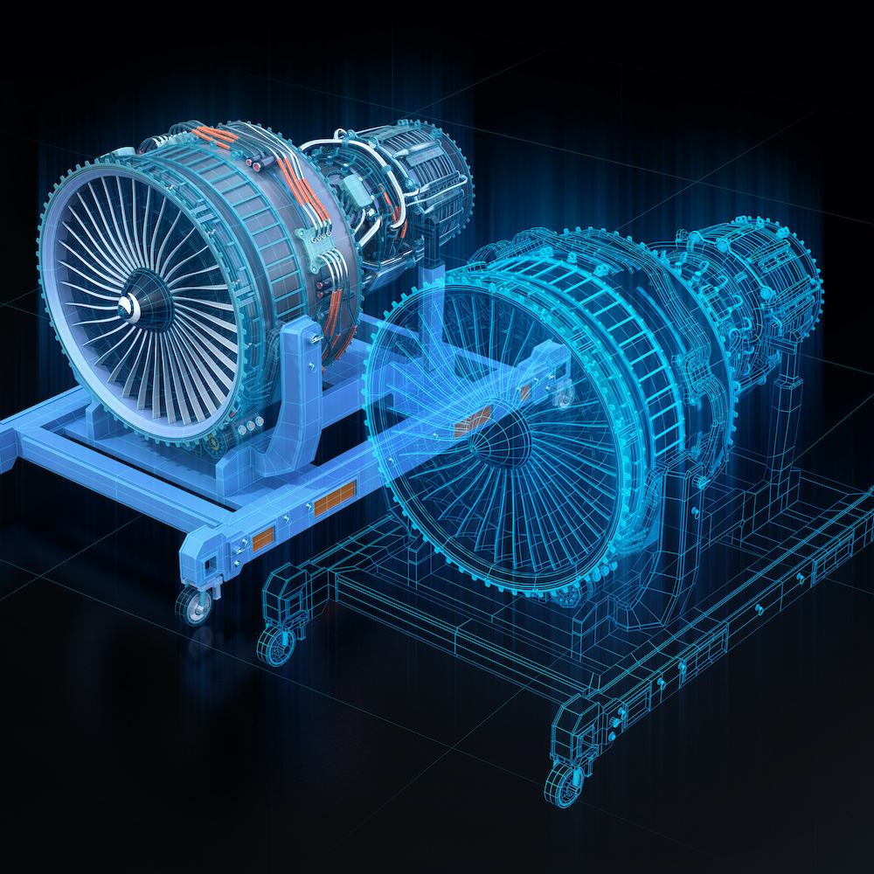
What is Digital Twin?
A digital twin is defined as a virtual representation of a physical thing.
The sensors connected to these physical assets collect data that is mapped onto the virtual model.
Digital twin enables people to see vital
information about how the physical thing
operates in the real world.

Slide 4
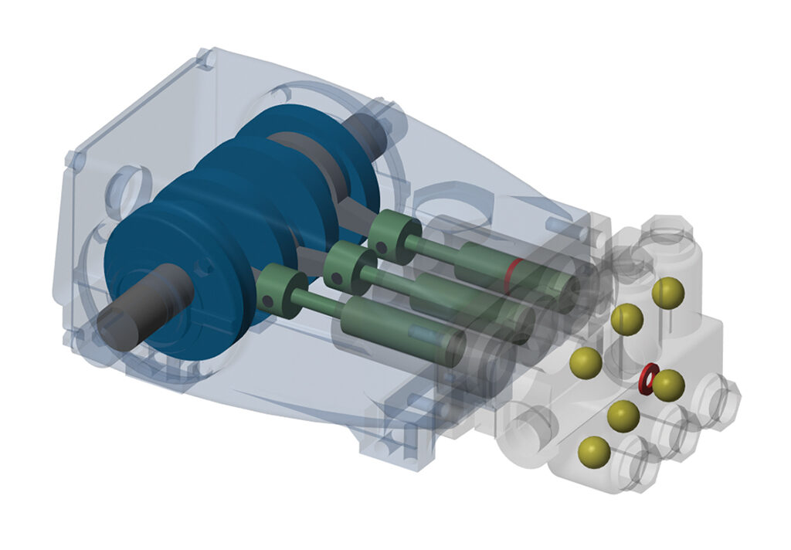
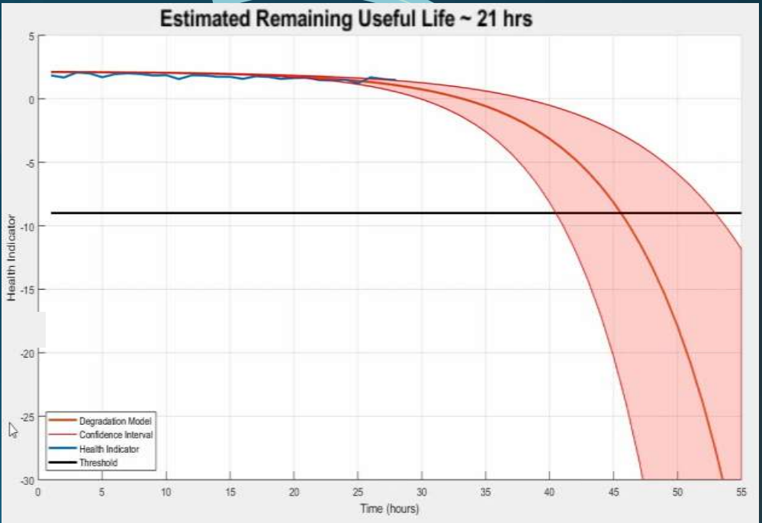

Slide 5
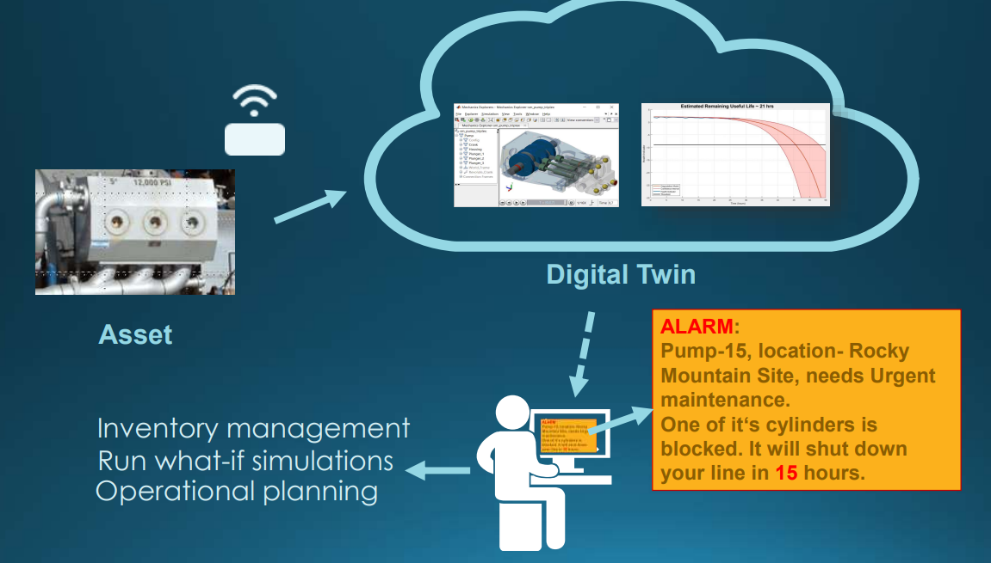

Slide 6

A digital twin is an up-to-date representation of a real asset in operation.

Slide 7
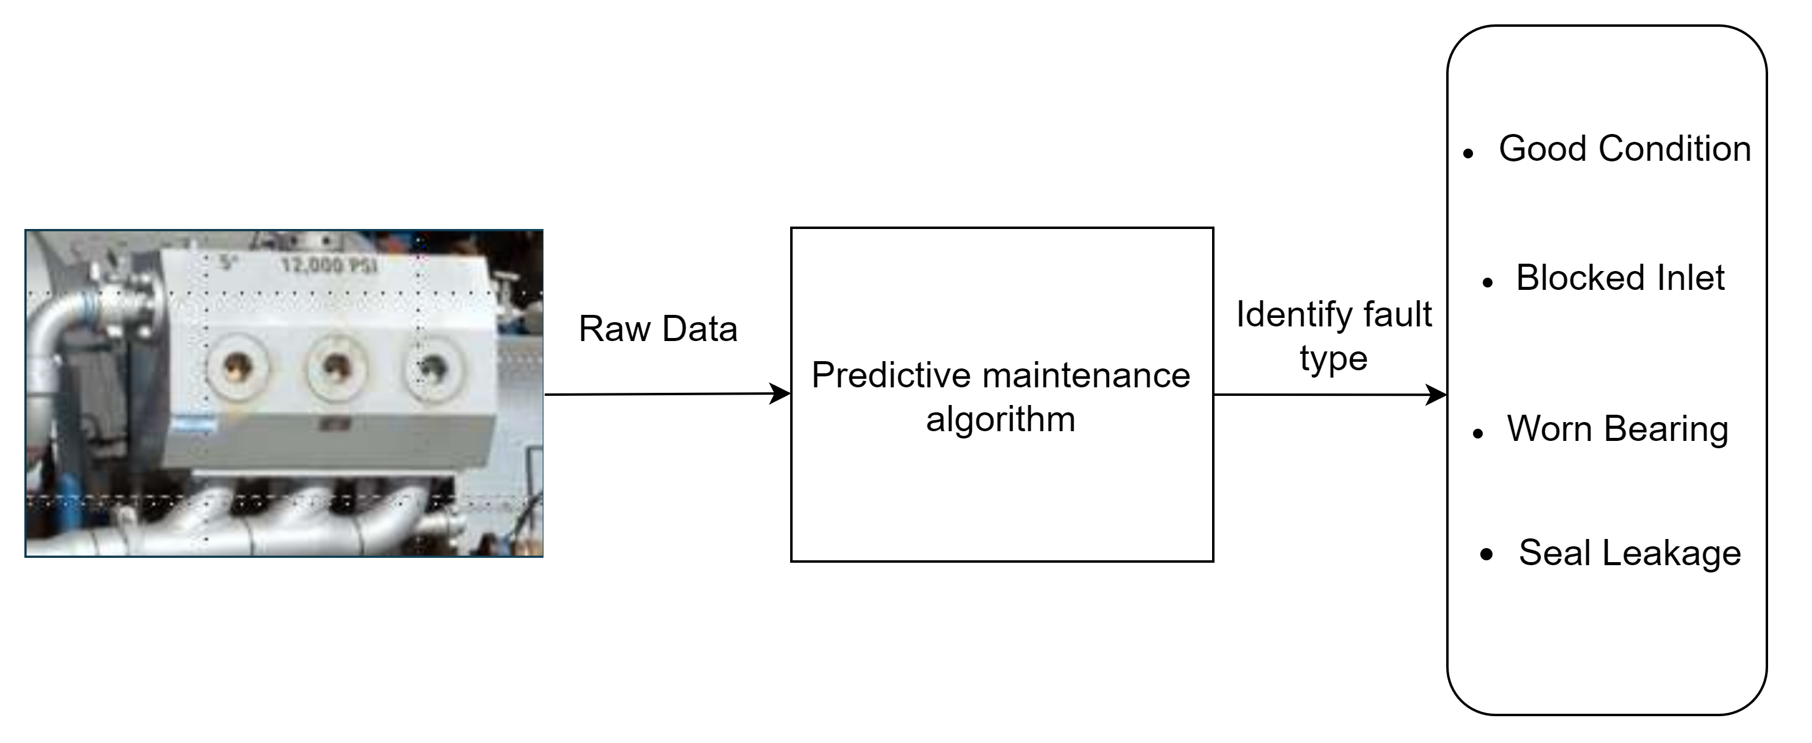

Slide 9

Use case – Fault classification of a pump
Objective:
Using machine data to determine what needs to be fixed
Solution:
Develop predictive Maintenance Algorithm

Slide 10
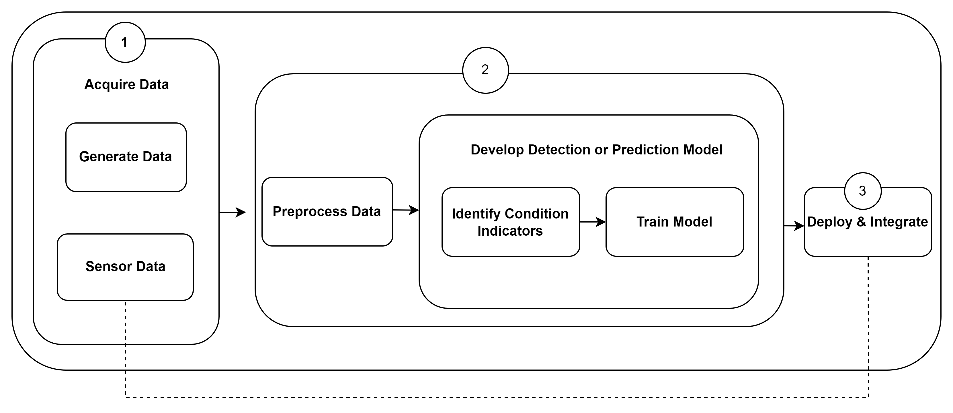
Approach

Slide 11
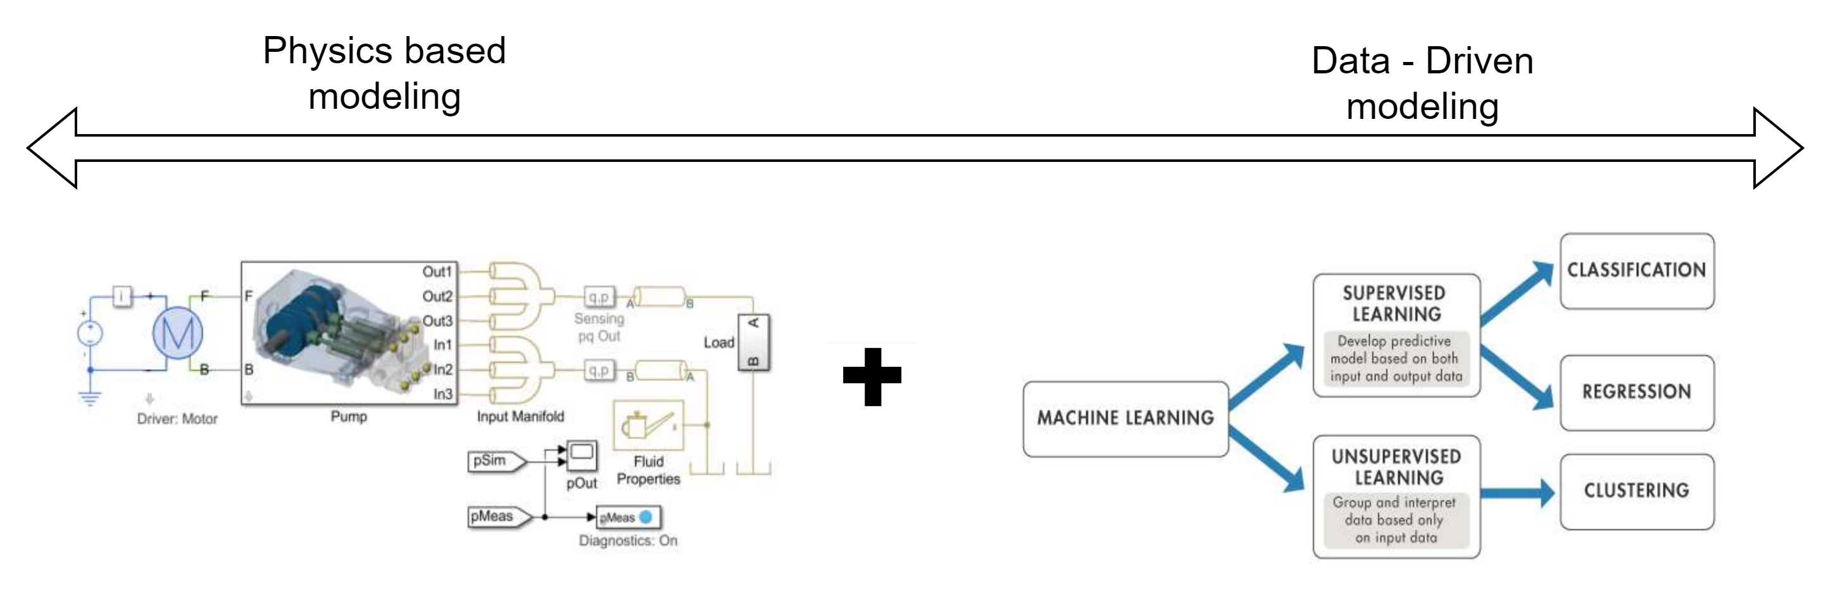
Capture Physics Captures behaviour using sensors

